Slide 1
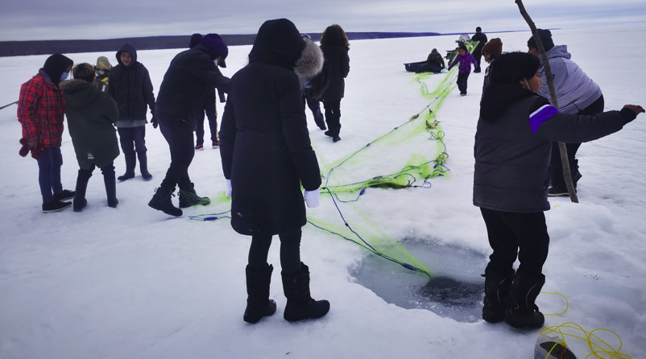
Picture Word Inductive Model

Slide 2
clouds
pulling
horizon
talking
cap
ski-doo
toque
trees
fur
teacher
mask
kissing
sled
man
looking
sweater
walking
girl
boy
gloves
coat
jacket
fish net
rubber boot’s
stick
fish
runners
socks
socks
pants
lake
ice
snow
water
rope
winter boot’s
hole
weight

Slide 3
Topic:
Ice fishing (PWIM)
PHASE 1
Procedure:
1. Read a story
2. Say, see, spell
3. Categorize the parts of speech
4. Show an example of categorizing
5. Students will categorize PWIM words
6. Handout words to each student,
have them write 3 adjectives that
best describes their word.

Slide 4
toque
talking
kissing
trees
cap
mask
walking
pulling
clouds
teacher
horizon
sweater
ski-doo
lake
students
stick
man
fishing net
girl
coat
boy
fish
jacket
pants
snow
winter boots
ice
rope
fur
hole
runners
rubber boots
gloves
socks
looking
water
weight
cold

Slide 5
clouds
c
l
o
u
d
s
students
snow
horizon
man
socks
skidoo
boy
fur
girl
jacket

Slide 6
rubber boots
ice
mask
winter boots
cap
lake
fishing net
hole
fish
sweater
rope

Slide 7
trees
teacher
pants
runners
stick
water
gloves
coat
cold
toque
weight

Slide 8
walking
the
was
looking
has
in
pulling
is
and
talking
on
have

Slide 9
c
l
o
d
toque
u
s
fur
fishing net
clouds
horizon
ice
sweater
pants
skidoo
rope
trees
stick
students
hole
cap
teacher
man
walking
rubber boots
coat
girl
looking
runners
fish
boy
kissing
mask
water
jacket
pulling
lake
winter boots
snow
talking
gloves
weight
socks
cold

Slide 10
Things you see and
feel in nature
Things people
would wear
Verbs / Action Words
Personal Pronouns
snow
jacket
pulling
girl
ice
runners
kissing
boy
lake
rubber boots
horizon
talking
man
gloves
students
water
looking
clouds
winter boots
teacher
walking
cold
pants
toque
One Syllable Words
coat
Personal Pronouns
cap
fur
socks
fishing net
fish
weight
stick
ski-doo
rope
Handout activities
hole

Slide 11
Things you see in nature
Things people
would wear
Verbs / Action Words
Personal Pronouns
snow
jacket
pulling
girl
ice
runners
kissing
boy
lake
rubber boots
horizon
talking
man
gloves
students
water
looking
clouds
winter boots
teacher
walking
pants
Personal Pronouns
toque
One Syllable Words
coat
cap
fur
ski-doo
socks
fishing net
fish
weight
stick
rope
End of Lesson
hole

Slide 12
22
E
31
25
18
2
4
26. rubber boots
20
19
A
13
27. winter boots
7
D
B
1
C
30
28. fishing net
29
23
28
12
29. students
21
5
15
26
30. sweater
9
32
16
31. teacher
17
8
14
32. runners
6
3
27
11
A. talking
10
24
B. looking
1. man
6. lake
11. rope
16. socks
21. gloves
C. walking
2. cap
7. girl
12. coat
17. pants
22. clouds
3. ice
8. snow
13. mask
18. trees
23. jacket
D. kissing
4. fur
9. fish
14. water
19. toque
24. weight
E. pulling
5. boy
10. hole
15. stick
20. skidoo
25. horizon
cold

Slide 13
Examples of words that describe the nouns…
1st example:
cloudy western
____________ horizon
beautiful
____________ horizon
transparent
____________ horizon
cement
2nd example:
____________ weight
heavy
____________ weight
bulky
____________ weight

Slide 14

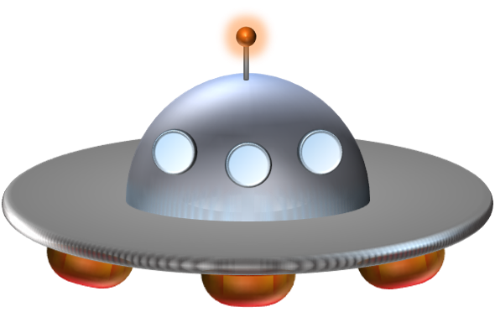

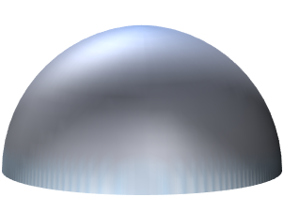


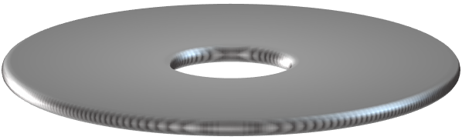

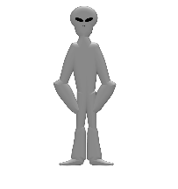



a
b
c
d
e
f
g
h
i
j
k
l
m
n
o
p
q
r
s
t
u
v
w
x
w
a
l
k
i
n
g
y
z
BUILD
Notes:
WALKING

Slide 15
a
b
c
d
e
f
g
h
i
j
k
l
m
n
o
p
q
r
s
t
u
v
w
x
t
e
a
c
h
e
r
y
z
BUILD
Notes:
TEACHER

Slide 16
a
b
c
d
e
f
g
h
i
j
k
l
m
n
o
p
q
r
s
t
u
v
w
x
r
u
n
n
e
r
s
y
z
BUILD
Notes:
RUNNERS

Slide 17
a
b
c
d
e
f
g
h
i
j
k
l
m
n
o
p
q
r
s
t
u
v
w
x
s
w
e
a
t
e
r
y
z
BUILD
Notes:
SWEATER

Slide 18
a
b
c
d
e
f
g
h
i
j
k
l
m
n
o
p
q
r
s
t
u
v
w
x
s
w
e
a
t
e
r
y
z
BUILD
Notes:
SWEATER

