Slide 1


# 1
tānisi
hello / hi

Slide 2
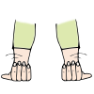
# 1
astam
come here (singular)

Slide 3
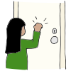
# 1
pīhtokwē
come in (singular)

Slide 4

# 1
api
sit down (singular)

Slide 5
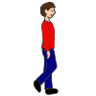
# 2
pimohtē
walk (singular)

Slide 6

# 2
pēta
bring (singular)

Slide 7

# 2
atoskē
work (singular)

Slide 8

# 2
nitohta
listen (singular)

Slide 9

# 3
wayawī
go outside

Slide 10

# 3
mētawē
play

Slide 11

# 3
awas
go away / go on!

Slide 12
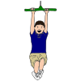
# 3
pēyāhtik
careful

Slide 13

# 4
cēskwa
wait

Slide 14

# 4
cēskwa pitamā
wait a minute

Slide 15

# 4
pimipahtā
run

Slide 16

# 4
wēwēpiso
swing

Slide 17
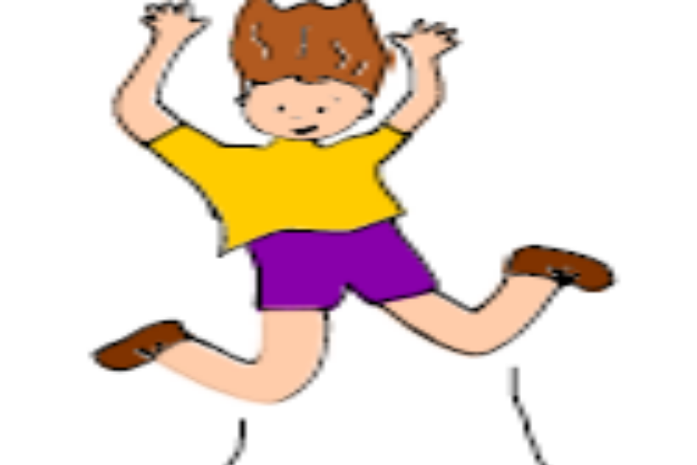
# 5
kwāskohti
jump

Slide 18

# 5
pākāhtowē
play ball

Slide 19
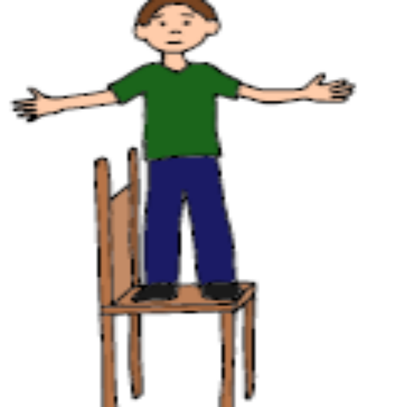
# 5
kīhcēkosī
climb up

Slide 20

# 5
wayawītimihk
outside

Slide 21
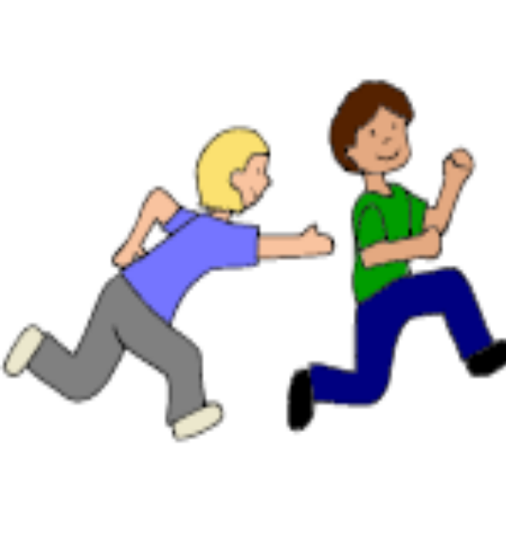
nitawē mētawē
go play

Slide 22
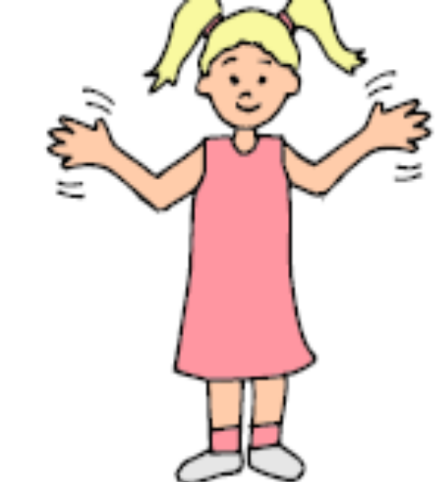
âsay
already

Slide 23

mīwasin
that’s good

Slide 24
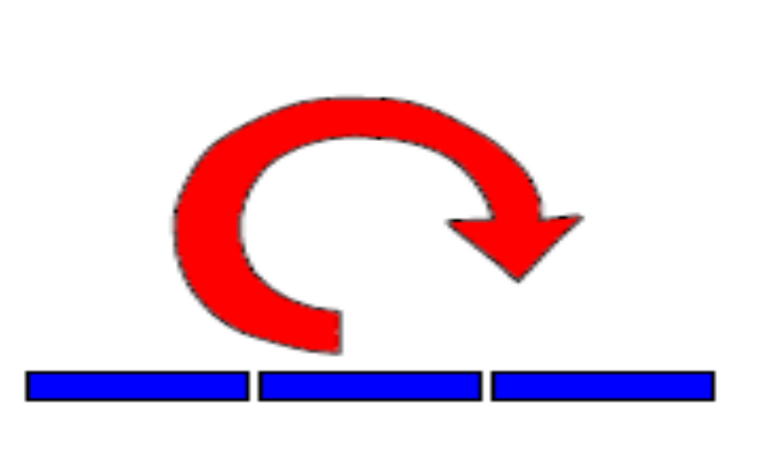
kīhtwam
again

Slide 25
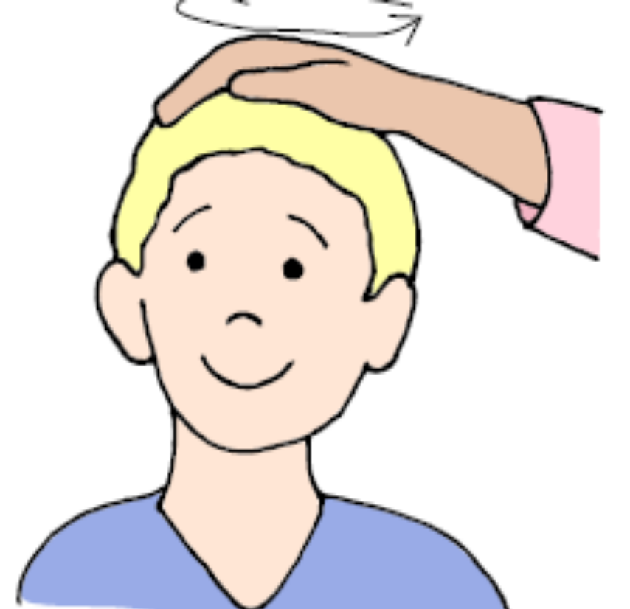

Slide 26


Slide 27


Slide 28
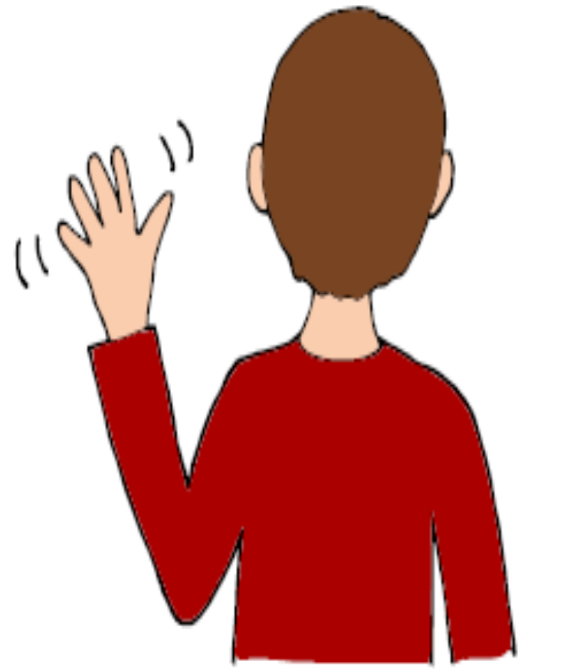

Slide 29


Slide 30
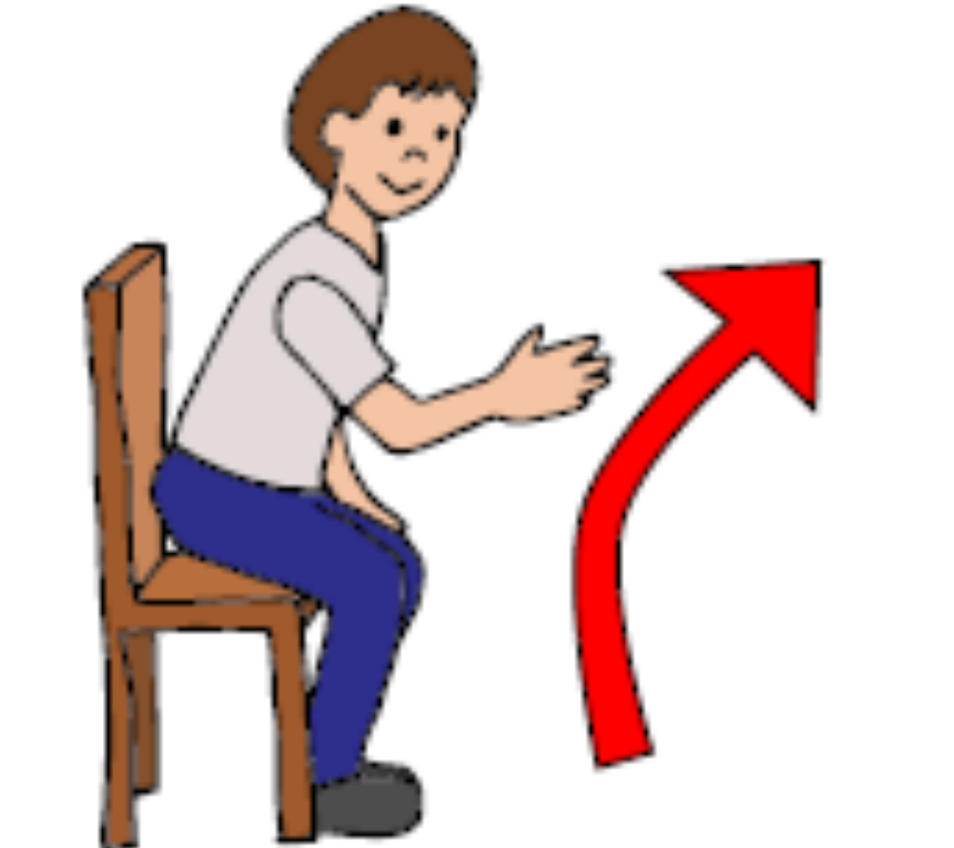

Slide 31


Slide 32


